Slide 1

DIGITAL IMAGE PROCESSING
TITLE: BONE FRACTURE DETECTION

Slide 2
Meet the Team
AYISHA DEVI.S
R. SWETHA
THRIVEDITHA
20MIS1005
20MIS1087
20MIS1081
Notes:
Now, Since we explained, how our Socirty Mang app---N-Palatimum can solve the existing problems in this system.
We are thereby concludinng our presention here.

Slide 3

INTRODUCTION
The image processing technique is extremely helpful for several applications like biomedical, security, satellite imaging, personal image, medicine, etc.
The research design involves data collection, preprocessing, segmentation, feature extraction, classification and evaluation of the proposed method. The sample dataset were x-ray images collected
In this we are using CNN (Convolution neural networks) to find the fracture. The proposed method can find suitable use in categorization of fracture types on different bone images based on the results obtained from the experiment.
Notes:
In General,
A Society includes Gated Communities, Corporate Offices, Small Scale Rented properties.
They all have their specific problems in terms of managing their space.
We plan to design a One-Stop Solution for managing these societies, and ease their routine through our software.
Society
Before we proceed further, Let us look at what problems do they face?

Slide 4
LITERATURE SURVEY
Medical imaging systems have been used in various medical application domains like trauma center orthopedic,pain management and vascular and non-vascular. One of the oldest and frequently used devices to capture humanbones is X-ray. Computer aided bone fracture detection technique is mainly implemented to assist doctors to providebetter diagnosis report. Bone fracture can occur in any part of human body such as the leg (tibia and fibula), hand(radius and ulna) and foot etc. The usage of medical images has been increasing tremendously due to a collection ofthousands of medical images every day in medical institutions. Due to the increase in medical images there is arising need of managing the data properly and accessing it accurately. Finding the correct boundary in noisyimages is still a difficult task. It introduces a new edge following technique for boundary detection in noisy images.Use of the proposed technique demonstrates its application to diverse cases of medical images. The proposedtechnique can detect the boundaries of objects in noisy images using the information the fracture detection on the xray images is founded. This paper mainly discusses the computer aided diagnosis of fracture detection in humanhand bone X-ray images. The proposed system has three steps. Namely, preprocessing, segmentation, and fracturedetection.

Slide 5
METHODOLOGY
Input Image
Image Enhancement
Image Segmentation
Feature Extraction
CNN classification
Output Image
Notes:
Read from book

Slide 6

DATA SET
In this we have 237 training files, 237 training annotation files, 40 Validations, 40 Validation annotation files

Slide 7

SOFTWARE USED
Kaggle online notebook
Kaggle is completely free on the actual Kaggle platform. You can however gain access to Kaggle notebooks on the paid version of Google Cloud Project, and this is how a Kaggle user can access more customizable environments with different GPUs, docker containers to use, etc.

Slide 8
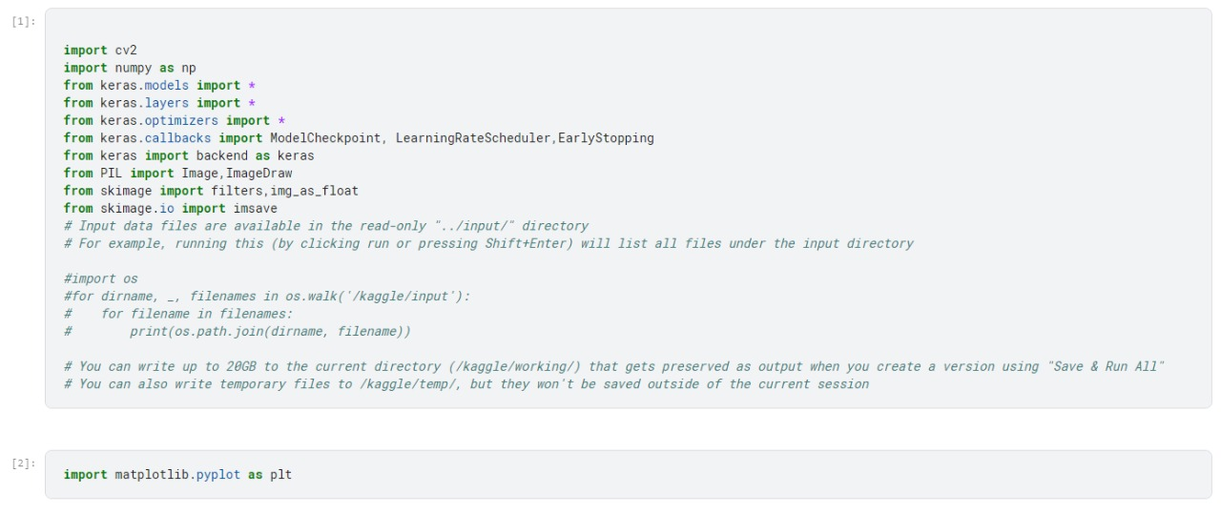
RESULT
Notes:
Good Work ain’t cheap.
Cheap work ain’t good.

Slide 9
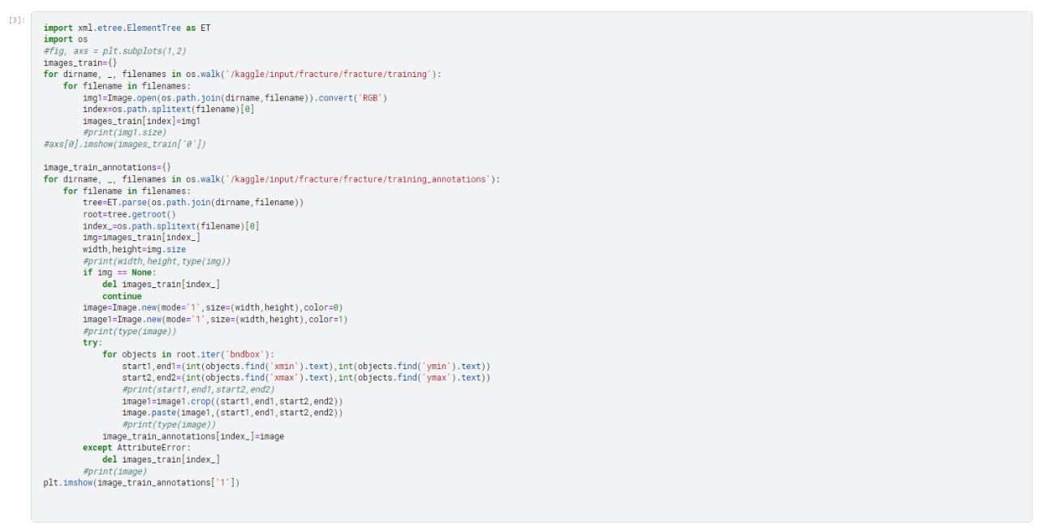
RESULT
Notes:
Good Work ain’t cheap.
Cheap work ain’t good.

Slide 10
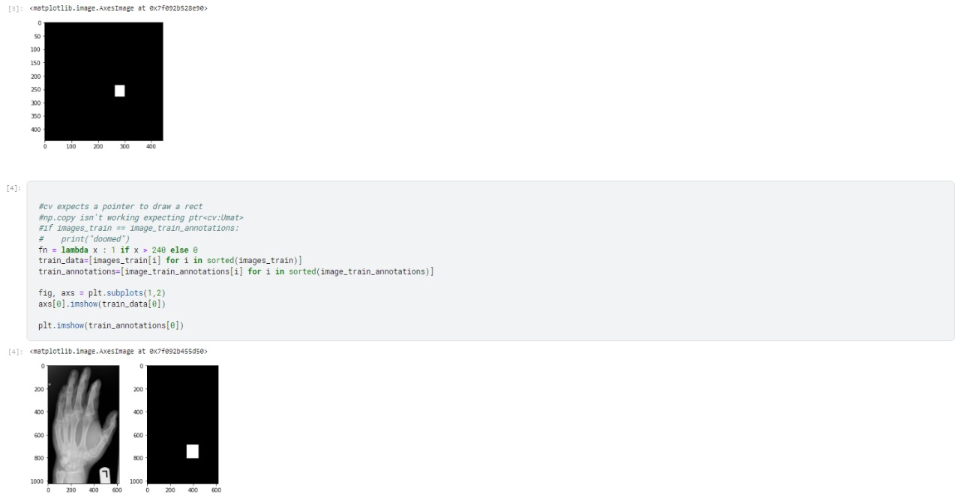
Notes:
Good Work ain’t cheap.
Cheap work ain’t good.

Slide 11
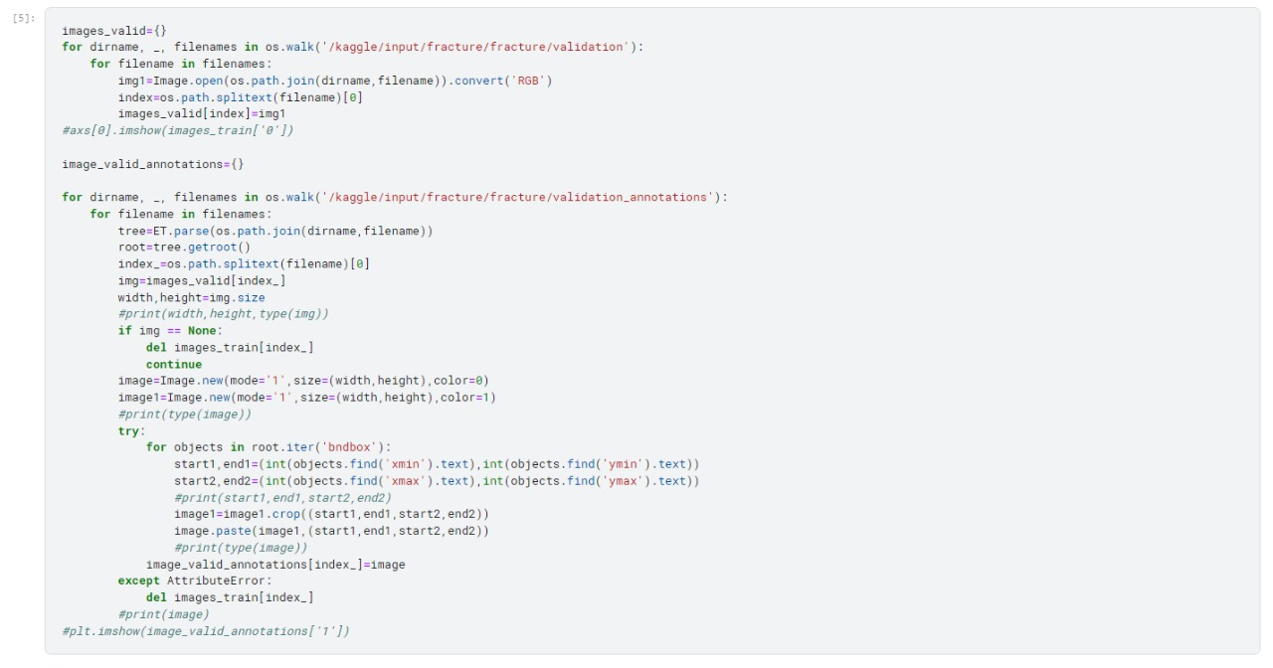
Notes:
Good Work ain’t cheap.
Cheap work ain’t good.

Slide 12
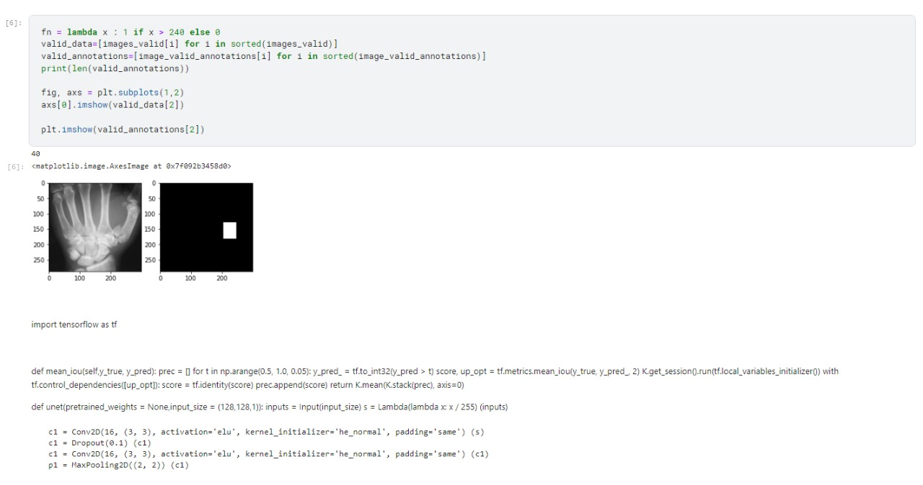
Notes:
Good Work ain’t cheap.
Cheap work ain’t good.

Slide 13
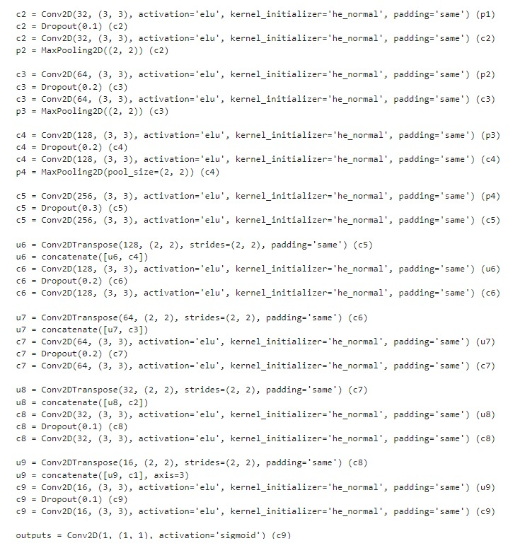
Notes:
Good Work ain’t cheap.
Cheap work ain’t good.

Slide 14
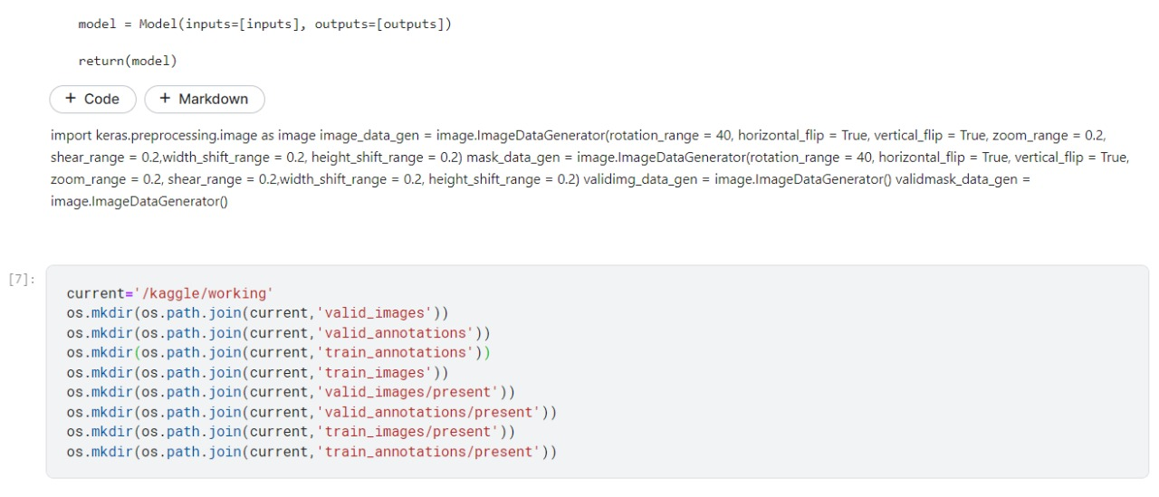
Notes:
Good Work ain’t cheap.
Cheap work ain’t good.

Slide 15
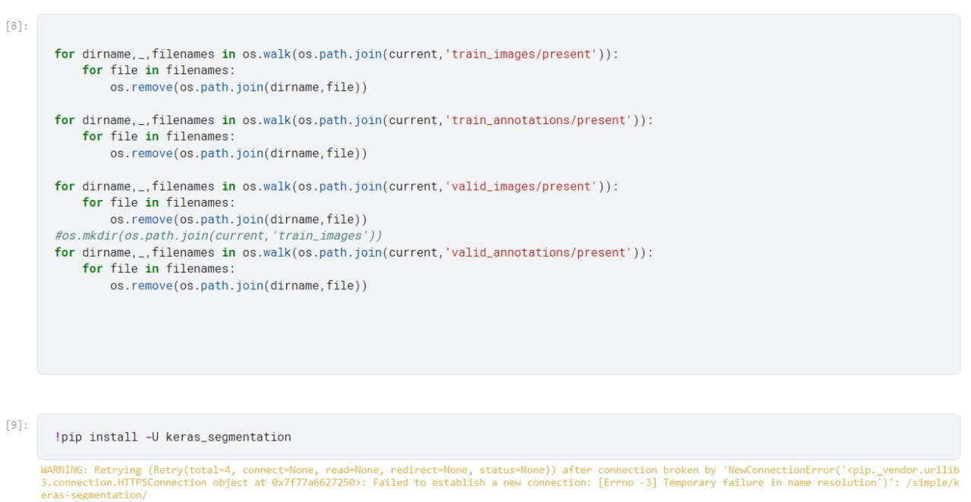
Notes:
Good Work ain’t cheap.
Cheap work ain’t good.

Slide 16
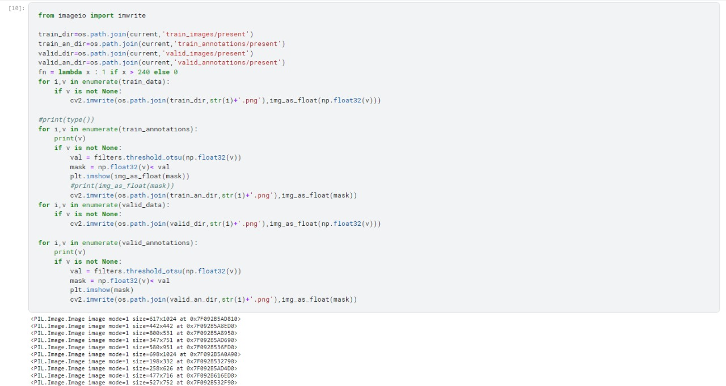
Notes:
Good Work ain’t cheap.
Cheap work ain’t good.

Slide 17
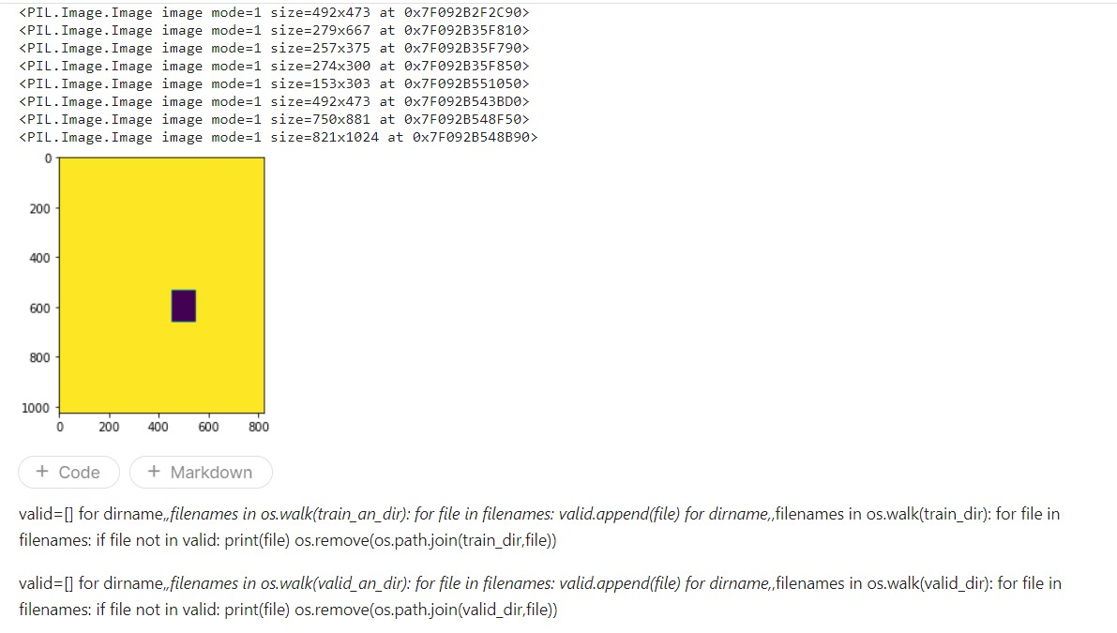
Notes:
Good Work ain’t cheap.
Cheap work ain’t good.

Slide 18
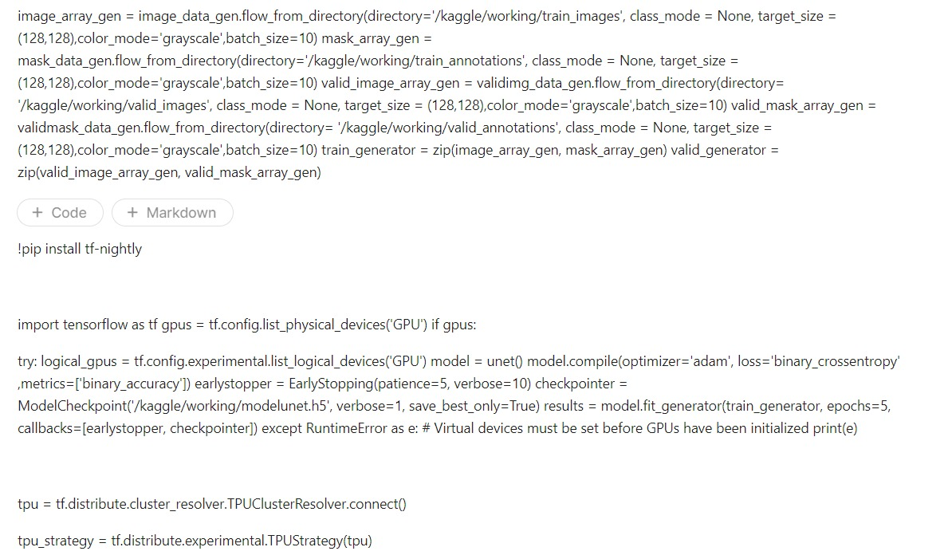
Notes:
Good Work ain’t cheap.
Cheap work ain’t good.

Slide 19
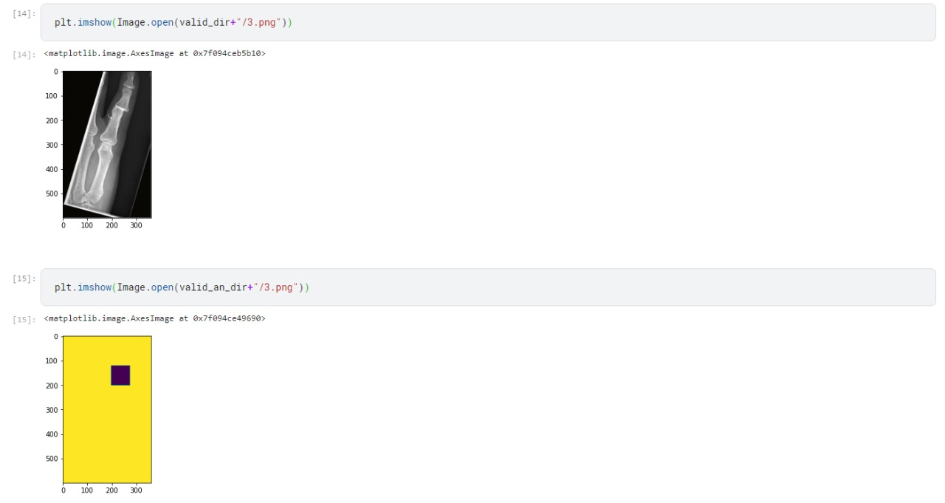
Notes:
Good Work ain’t cheap.
Cheap work ain’t good.

Slide 20
The ability of an object detection CNN to detect and localize radius and ulna fractures on wrist radiographs with high sensitivity and specificity was demonstrated. An in-depth analysis of the methods’ output has shown that heat maps can be blurry while bounding boxes are more precise in providing the correct fracture region. Hence, it might be interesting to fuse the two models as a model assembly outputting a bounding box around the fracture as well as the fracture’s heat map. That way, we would obtain the best of both worlds: the correct number of fractures from bounding boxes and pixel-wise fracture detection inside the bounding box.
Bone fracture detection
CONCLUSION

Slide 21
REFERENCES:
https://www.sciencedirect.com/science/article/pii/S1110016821001605
https://ijcrt.org/papers/IJCRT22A6087.pdf
https://pubs.rsna.org/doi/full/10.1148/ryai.2019180001

Slide 22
THANK-YOU

